Slide 1
How to make an infographic
Here is where this template begins

Slide 2
How to make an infographic
Despite being red, Mars is a cold place
Jupiter is a gas giant and the biggest planet
Information
Graphic
Infographic
Mercury is the closest planet to the Sun

Slide 3
How to make an infographic
01
Visualize key metrics and data
Mercury is the closest planet to the Sun
02
Simplify communication
Despite being red, Mars is a cold place
03
Clarify complex information
Jupiter is a gas giant and the biggest planet
04
Compare ideas or products
Neptune is very far from the Sun

Slide 4
How to make an infographic
Mercury
Mercury is the closest planet to the Sun
Create visual rhythm through repetition
Mars
Despite being red, Mars is a cold place
Jupiter
Jupiter is a gas giant and the biggest planet

Slide 5
How to make an infographic
Concepts
Data
Graphic representation
Mercury is the closest planet to the Sun
Jupiter is a gas giant and the biggest planet
Patterns
Information
Despite being red, Mars is a cold place
Neptune is very far from the Sun

Slide 6
How to make an infographic
01
Mercury
Mercury is the closest planet to the Sun
02
Mars
Use graphic elements to organize content
Despite being red, Mars is a cold place
03
Jupiter
Jupiter is a gas giant and the biggest planet
04
Neptune
Neptune is very far from the Sun

Slide 7
How to make an infographic
Search phase
01
02
03
Investigation
Incubation
Concept
Mercury is the closest planet to the Sun
Despite being red, Mars is a cold place
Jupiter is a gas giant and the biggest planet

Slide 8
How to make an infographic
Production phase
01
02
Idea selection
Digital implementation
Mercury is the closest planet to the Sun and the smallest one in the entire Solar System
Saturn is a gas giant and has several rings. It's composed of hydrogen and helium

Slide 9
How to make an infographic
Criticism
Evaluate the project
Check suitability
Verification
Snap to target

Slide 10
How to make an infographic
Statistical infographics
Process infographics
Jupiter is a gas giant and the biggest planet
Neptune is the farthest planet from the Sun
Informational infographics
Timeline infographics
Mercury is the closest planet to the Sun
Despite being red, Mars is a cold place
List infographics
Comparison infographics
Venus has a beautiful name but is hot
Pluto is considered a dwarf planet

Slide 11
How to make an infographic
Final artwork & presentation
Present to the client
Mercury is the closest planet to the Sun and the smallest one
Collect their suggestions
Saturn is a gas giant composed of hydrogen and helium

Slide 12
How to make an infographic
Statistical infographics
Highlight data
Neptune is the farthest planet from the Sun
Share interesting figures
Despite being red, Mars is a cold place
Condense information
Pluto is considered a dwarf planet

Slide 13
How to make an infographic
Process infographics
Step 4
Produce
Jupiter is a gas giant and the biggest planet
Step 3
Sketch
Step 2
Concept
Step 1
Research

Slide 14
How to make an infographic
Define your goals
Gather information
Identify your audience
Mercury is the closest planet to the Sun
Despite being red, Mars is a cold place
Jupiter is a gas giant and the biggest planet

Slide 15
How to make an infographic
Big typography for the headlines for visual hierarchy
Lists like this can help you organize your content
Report on data
Reveal patterns
Simplify information
Highlight events
Compare concepts
Explain a process
Which are the goals when designing an infographic?

Slide 16
How to make an infographic
Use a table to compare products or services
Features | Option 1 | Option 2 | Option 3
Mercury is the closest planet to the Sun
Venus is the second planet from the Sun
Despite being red, Mars is a cold place

Slide 17
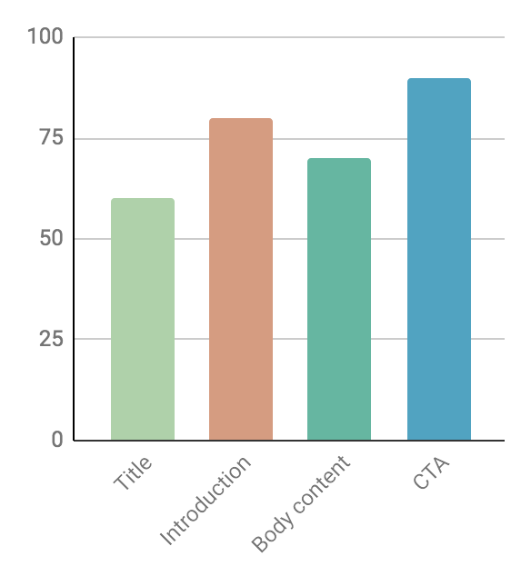
How to make an infographic
60%
80%
Title
Introduction
Jupiter is a gas giant and the biggest planet
Mercury is the closest planet to the Sun
70%
90%
Body content
Call to action
Neptune is very far from the Sun
Despite being red, Mars is a cold place
Follow the link in the graph to modify its data and then paste the new one here. For more info, click here

Slide 18
How to make an infographic
Comparison infographics
01
Vs
02
Jupiter
Neptune
Jupiter is a gas giant and the biggest planet
Neptune is the farthest planet from the Sun
Mercury
Mars
Mercury is the closest planet to the Sun
Despite being red, Mars is a cold place

Slide 19
How to make an infographic
04
Mercury
Stages infographics
Mercury is the closest planet to the Sun
03
Mars
Despite being red, Mars is a cold place
02
Jupiter
Jupiter is a gas giant and the biggest planet
01
Neptune
Neptune is very far from the Sun

Slide 20
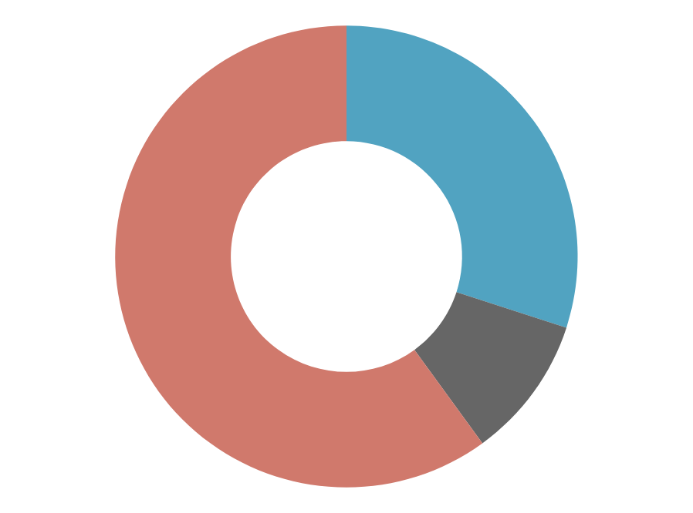
How to make an infographic
30%
Secondary color
60%
Despite being red, Mars is a cold place
Primary color
Mercury is the closest planet to the Sun
10%
Emphasis color
Jupiter is a gas giant and the biggest planet
Follow the link in the graph to modify its data and then paste the new one here. For more info, click here

Slide 21
How to make an infographic
Clarity
Easy to scan
Jupiter is the biggest planet of them all
Mercury is the closest planet to the Sun
Research
Appealing
Venus has very high temperatures
Pluto is considered a dwarf planet

Slide 22
How to make an infographic
Good infographics
Offer clarity
Mercury is the closest planet to the Sun
Tell a story
Despite being red, Mars is a cold place
Are easy to read
Jupiter is a gas giant and the biggest planet

Slide 23
How to make an infographic
Use timeline infographics to show how long something will take
01
Jupiter
Jupiter is the biggest planet of them all
Mercury
02
Mercury is the closest planet to the Sun
03
Pluto
Pluto is considered a dwarf planet
Venus
04
Venus has a nice name but is very hot

Slide 24
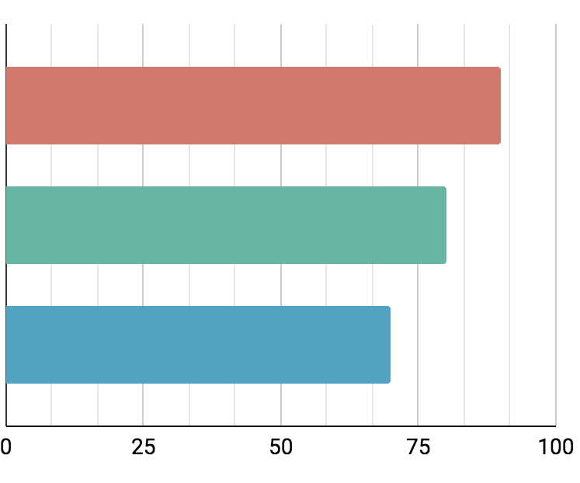
How to make an infographic
Define your goals
90%
Mercury is the closest planet to the Sun
Gather information
80%
Despite being red, Mars is a cold place
Identify your audience
70%
Jupiter is a gas giant and the biggest planet
Follow the link in the graph to modify its data and then paste the new one here. For more info, click here

Slide 25
How to make an infographic
Investigation
01
Mercury is the closest planet to the Sun
Incubation
02
Despite being red, Mars is a cold place
Concept
03
Jupiter is a gas giant and the biggest planet

Slide 26
How to make an infographic
Comparison of two statistics
Vs
55%
45%
Mercury
Saturn
Mercury is the closest planet to the Sun and the smallest one in the entire Solar System
Saturn is a gas giant and has several rings. It's composed of hydrogen and helium

Slide 27
How to make an infographic
Use a checklist to identify completed tasks
 |  | Despite being red, Mars is a cold place full of iron oxide dust
 |  | Saturn is composed mostly of hydrogen and helium
 |  | Venus has a very beautiful name but is actually terribly hot
 |  | Jupiter is a huge gas giant named after a Roman god
 |  | Earth is the only planet that harbors life in the Solar System

Slide 28
How to make an infographic
Start with some insights
01
Mercury is the closest planet to the Sun
Be concise and specific
02
Despite being red, Mars is a cold place
Try to establish a narrative
03
Jupiter is a gas giant and the biggest planet
Use resources from Freepik
04
Venus has a nice name but is very hot

Slide 29
How to make an infographic
A
Venus
Saturn
Venus has a beautiful name
It’s a gas giant and has rings
B
Mars
Mars is actually a cold place
Here’s a process map!
C
Earth
Neptune
Earth is the third planet
Neptune is far from the Sun
D
Mercury
Mercury is the smallest planet

Slide 30
How to make an infographic
Story
Simplicity
No
Mercury is the closest planet to the Sun
Jupiter is a gas giant and the biggest planet
01
Yes
02
Yes
03
Style
Good infographics
No
No
Despite being red, Mars is a cold place

Slide 31
How to make an infographic
Showing a process using a pyramide
Jupiter
Jupiter is a gas giant and the biggest planet
Mercury
Mercury is the closest planet to the Sun
Venus
Venus has a beautiful name but is hot

Slide 32
How to make an infographic
$300K
Localization
01
Neptune is very far from the Sun
$50K
$30K
Statistics
02
Mercury is the closest planet to the Sun
Data visualization
03
$100K
Pluto is now considered a dwarf
Comparison
04
Venus has a beautiful name but is hot

Slide 33
Instructions for use (premium users)
As a Premium user, you can use this template without attributing Slidesgo.
You are allowed to:
Modify this template.
Use it for both personal and commercial purposes.
Hide or delete the “Thanks” slide and the mention to Slidesgo in the credits.
Share this template in an editable format with people who are not part of your team.
You are not allowed to:
Sublicense, sell or rent this Slidesgo Template (or a modified version of this Slidesgo Template).
Distribute this Slidesgo Template (or a modified version of this Slidesgo Template) or include it in a database or in any other product or service that offers downloadable images, icons or presentations that may be subject to distribution or resale.
Use any of the elements that are part of this Slidesgo Template in an isolated and separated way from this Template.
Register any of the elements that are part of this template as a trademark or logo, or register it as a work in an intellectual property registry or similar.
For more information about editing slides, please read our FAQs or visit Slidesgo School:
https://slidesgo.com/faqs and https://slidesgo.com/slidesgo-school

Slide 34
Infographics
You can add and edit some infographics to your presentation to present your data in a visual way.
Choose your favourite infographic and insert it in your presentation using Ctrl C + Ctrl V or Cmd C + Cmd V in Mac.
Select one of the parts and ungroup it by right-clicking and choosing “Ungroup”.
Change the color by clicking on the paint bucket.
Then resize the element by clicking and dragging one of the square-shaped points of its bounding box (the cursor should look like a double-headed arrow). Remember to hold Shift while dragging to keep the proportions.
Group the elements again by selecting them, right-clicking and choosing “Group”.
Repeat the steps above with the other parts and when you’re done editing, copy the end result and paste it into your presentation.
Remember to choose the “Keep source formatting” option so that it keeps the design. For more info, please visit Slidesgo School.

